Slide 1
Network Attacks
INFSCI 1075: Network Security – Spring 2013
Amir Masoumzadeh

Slide 2
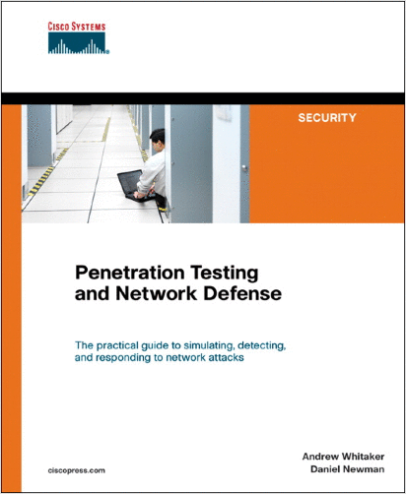
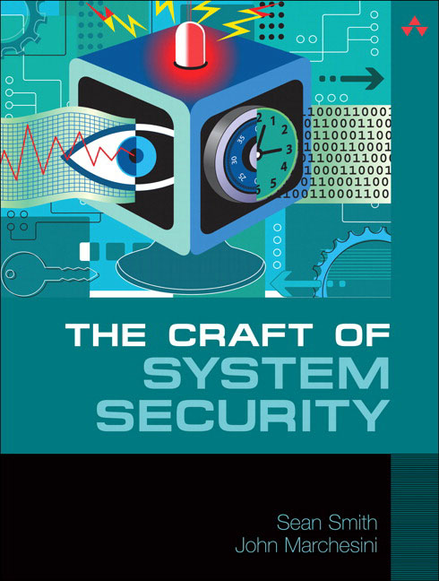
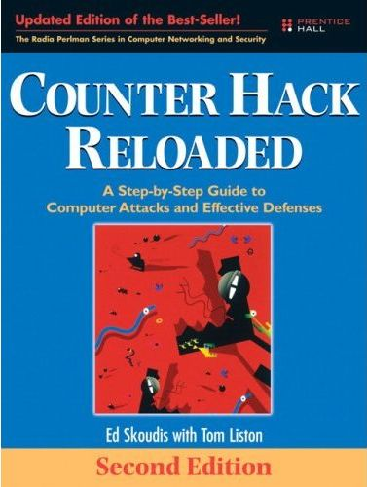
Some References
For those who are interested in more information about computer attacks and “hacking”:
Hacking Exposed [Read online]
Penetration Testing and Network Defense
The Basics of Hacking and Penetration Testing [Read online]
The Craft of System Security
Counter Hack Reloaded

Slide 3
Some References
For up-to-date info on vulnurabilities and exploits
CERT - http://www.us-cert.gov/cas/techalerts/index.html
Security Focus
Main Page - http://www.securityfocus.com/
Vulnurabilities - http://www.securityfocus.com/vulnerabilities
Windows Security - http://www.windowsecurity.com/
Linux Security - http://www.linuxsecurity.com/content/section/3/170/

Slide 4
Terminology Review
Asset
Network or system resource that has value
Examples - bandwidth, web server, CPU cycles, database with credit card numbers, e-mail with confidential data
Vulnerability
Weakness in the asset that can be exploited
Example - Access to network bandwidth for anyone without authentication or controls
Threat
A person capable of and wanting to exploit a vulnerability in an asset
Sometimes it is expressed as an abstract event that could occur rather than specifically identifying someone who is a threat
Exploit
A piece of software, a chunk of data, or sequence of commands that take advantage of a bug, glitch or vulnerability in order to cause unintended or unanticipated behavior to occur on computer software or hardware

Slide 5
Outline
Reconnaissance (aka, Footprinting)
Combination of active and passive reconnaissance techniques for the purpose of establishing a strategy of attack
Data gathering (mostly passive)
Scanning (mostly active)
Application Attacks (only a little)
Buffer overflows
Network Attacks
A whole bunch
Some Tools

Slide 6
Vulnerabilities
Cannot get rid of all of them
Poor design - buggy code
Architectural weaknesses - in software and hardware
Poor implementation - users do not deploy assets in the right way
Poor containment - asset can be used for things it was not meant to be
Users – users do not put in enough effort towards that!

Slide 7
Reconnaissance
Most attacks begin with a lot of research
Before beginning an attack, hackers may research information on
Network typology
Network devices and systems
Normal usage patterns
Employee information
Security systems (physical and electronic)
etc.
This is usually done over a period of time.

Slide 8
Social Engineering
Reconnaissance often employs as many “low-tech” techniques as high-tech ones
Social engineering is one such technique
Attacker makes contact with employee or person associated with target
Convinces them to reveal sensitive information
Exploits the human element of information systems (often the weakest link)
Bypasses all IDS, IPS, Firewalls, Logging systems, etc.
Hard to trace and detect
What if an attacker targets a new or disgruntled employee?
Social engineering attacks are often successful

Slide 9
Social Engineering (cont.)
Some classic pretexts
“New employee” calls the help desk. He / she can't figure out how to do a particular task
“Angry manager” calls a lower level employee because a system has stopped working
A “system administrator” calls an employee to fix something on the system
An “employee” has lost some important information and calls another employee to get this information

Slide 10
Physical Break-Ins
Attackers may pose as employees or other “normal” personnel (e.g., delivery, maintenance, etc.)
Once inside, an attacker may have access to
Physical machines
Possibly unprotected
Plant backdoors
Other hardware and infrastructure
Telephone lines
Wiring closets / racks
Internal network access
Documented information
Dumpster diving

Slide 11
Publicly Available Information
Public information can contain things that can help hacker break into targets
Company web pages
Related organizations
Location details
Phone numbers, contact names, emails, etc.
Current events (mergers, acquisitions, layoffs, etc.)
etc.

Slide 12
Searching the Web - Google
So called “Google hacking”, is now a popular method of researching a target (or finding one)
Google hacking is
Fast
Very efficient
Low risk
Google finds all the information you forgot you even had
Can be used to find any number of specific or random targets
Example: “VNC Desktop” inurl:5800
More examples in Google Hacking Database: http://www.hackersforcharity.org/ghdb/

Slide 13
Google Operatives

Slide 14
Company's Website
May contain information about
Employees
Contact info
Corporate structure
Corporate culture & language
Business partners
Technologies in use
Open job requisitions
What if a company is looking for a firewall administrator for Cisco firewalls?
An attacker may cache the entire website for an organization (wget, Teleport Pro)
Raw directories may reveal something a site does not
Less prolonged contact

Slide 15
WHOIS Database
ICANN (Internet Corporation for Assigned Names and Numbers ) and ASO(Address Supporting Organization) divide IP blocks and distribute them to local internet registries
Local registries manage and distribute these addresses and names
They keep public records on domain registrants
InterNIC - http://www.internic.net
APNIC - http://www.apnic.net
ARIN - http://www.arin.net
LACNIC – http://www.lacnic.net
RIPE - http://www.ripe.net
AfriNIC - http://www.afrinic.net
and some others…

Slide 16
DNS Interrogation
DNS information is meant to be available globally
“nslookup” and “dig” are two common commands to lookup addresses and names in an organization
Network Layout
Services running
www.????.com should be running a web server
Is vnc.????.com running a VNC server?
Main servers & other critical infrastructure
Used in DNS Zone transfer attacks

Slide 17
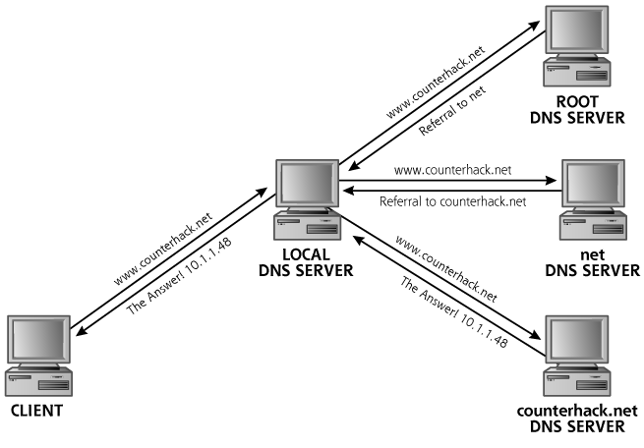
DNS lookup

Slide 18
DNS Interrogation (cont.)
Using -d with nslookup will list all records for the domain
Sometimes the host information is also included (OS, version, architecture, etc.)
Typically, this option is disabled by most administrators except for the secondary name server
Many times it uses name/address based authentication
Even with zone transfers disabled, attackers can (slowly) perform reverse lookups against the entire IP space
nslookup is available on both Unix-like and Windows OSs
use dig on Unix-like systems

Slide 19
Network Mapping
ICMP Echo scanning
Attacker may “sweep” the entire network with pings
Determines live hosts
May be easily detectible depending on “speed” and “source”
Can also be done using other protocols
Tracerouting
Determines path to a destination
Maps network devices and routes
Gives attacker information about routes AND hosts
Can be ICMP, UDP, TCP, etc.
Tools: ping, traceroute, Sam Spade, nmap, cheops-ng

Slide 20
Port Scanning
Process of attempting to connect to TCP and UDP ports on target system to know:
What ports are open?
What ports are closed?
What ports are protected?
What services / applications are running?
Information regarding these services / applications
What OS is the target running?
Greatly supplements attack plans

Slide 21
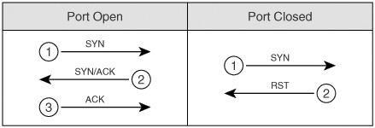
Port Scanning – Types
TCP Connect
Attempts to complete the TCP three-way handshake with each scanned port
Not at all stealthy (can be captured by network and application logs)

Slide 22
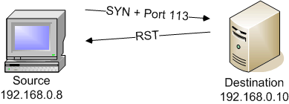
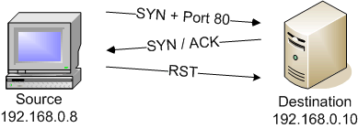
Port Scanning – Types (cont.)
TCP SYN Scan
Only sends the initial SYN and awaits the SYN-ACK response to determine if a port is open
If the port is closed, the destination will send a RESET or nothing
Stealthier than Connect scans
No application logs, but still logged at network level

Slide 23
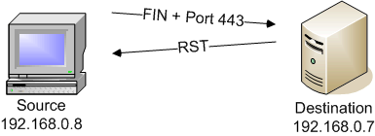
Port Scanning – Types (cont.)
TCP FIN Scan
Sends a TCP FIN to each port
A RESET indicates that the port is closed (according to TCP protocol)
No response may mean the port is open (or protected)
Stealthier than Connect and SYN scans (“Stealth Scan”)

Slide 24
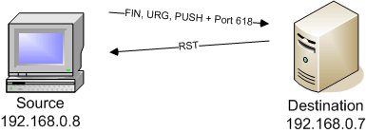
Port Scanning – Types (cont.)
TCP Xmas Tree Scan
Sends a packet with all control bits set (URG, ACK, PSH, RST, SYN, and FIN)
lit up like a Christmas tree
A RESET indicates the port is closed
No response may mean open (or protected) port
Used for stack fingerprinting (more later)
“Stealth Scan”

Slide 25
Port Scanning – Types (cont.)
Null Scan
Sends a packet with no control bits set
RST indicates that the port is closed
Nothing may mean port is open
“Stealth Scan”

Slide 26
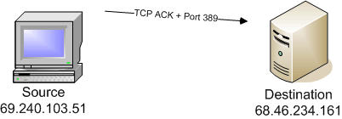
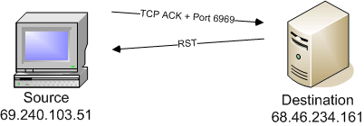
Port Scanning – Types (cont.)
TCP ACK Scan
Sends a packet with the ACK control bit set to each target port
No response or ICMP destination unreachable means port is “filtered”
RST packet means open port
Used for determining
If host is present
Determining rules for firewall/packet filter

Slide 27
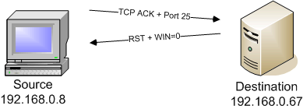
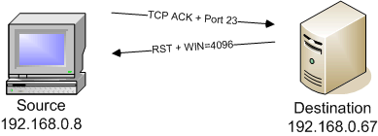
Port Scanning – Types (cont.)
Window Scan
Similar to ACK Scan
Issues a packet with the ACK flag set
If response is sent, inspects the window field of packet
For some OSs
Response with 0 window means = closed
Response with window > 0 = open port
May yield information regarding OS type

Slide 28
Port Scanning – Types (cont.)
FTP Bounce Scan
Not directly a port scan
Bounces scans of a (public) FTP server
Steps
Attacker connects to “bounceable” ftp server
Attacker issues PORT command
Contain IP address in DES and port in a pairing
e.g., PORT 192.168.0.5.2.44 refers to IP address 192.168.0.5 and port (2*256)+44, or port 556
Attacker then sends LIST command
A close port will inform user that ftp server can’t build connection
An open port will report a successful connection

Slide 29
Port Scanning – Types (cont.)
FTP Bounce Scan (cont.)

Slide 30
Port Scanning – Types (cont.)
Idle Scan
An advanced but extremely covert scanning technique
Uses an unwitting “zombie” and spoofed packets to achieve scanning
Takes advantage of predictable IPID field of IP packets

Slide 31
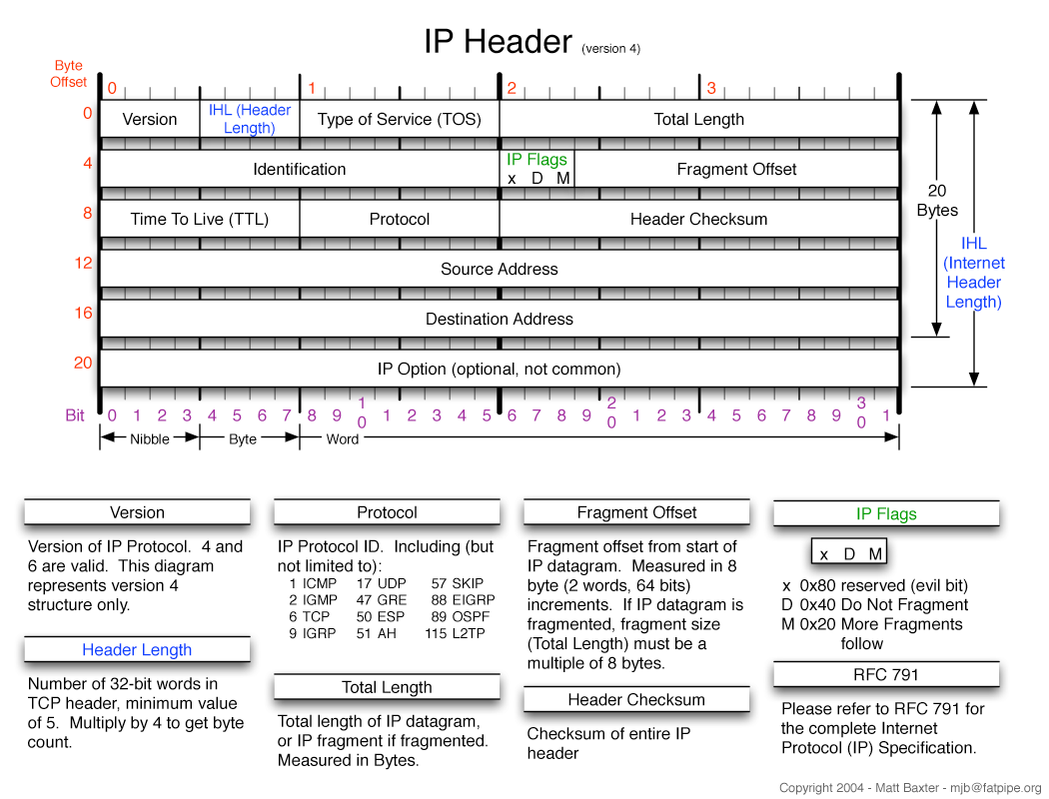
Idle Scan

Slide 32
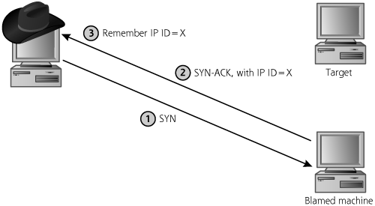
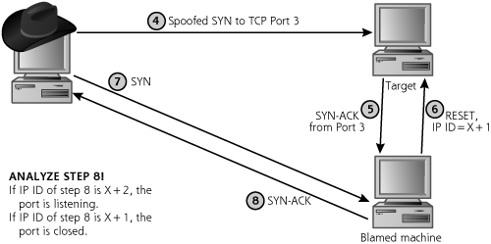
Idle Scan
Blamed machine must have two characteristics:
Have a predictable IP ID field (ideally, incrementing by one for each packet it sends)
Cannot send much traffic; it has to be idle, which gives this scan type its name

Slide 33
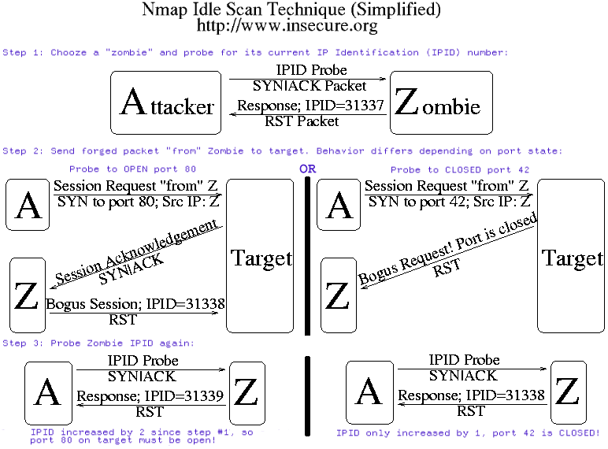

Slide 34
RPC Scanning
Remote Procedure Call
Application layer protocol
Allows developers to extend procedure calls across a network
Code executed on local computer until it needs information from another system
Local program then calls RPC program on another system
Processing continues on remote machine
When remote system has finished the procedure
Returns results and execution flow to original machine
Don't need to know specifics, just understand concept

Slide 35
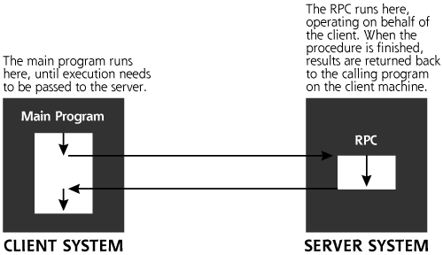
RPC Operation

Slide 36
More on RPC
RPC Examples:
Rpc.rstatd – returns performance statistics from servers' kernel
Rwalld – allows messages to be sent to users logged into PC
Rup – displays current up time and load average of server
Similar protocols:
Java's Java Remote Method Invocation (Java RMI) API provides similar functionality to standard UNIX RPC methods
XML-RPC is an RPC protocol which uses XML to encode its calls and HTTP as a transport mechanism
Microsoft .NET Remoting offers RPC facilities for distributed systems implemented on the Windows platform

Slide 37
RPC Scanning
Scanner uses (or obtains) list of open ports
Connect to each port
Sends null RPC commands to each open port
Response dictates the type of service running on the port
Allows the hacker to compile a list of RPC services running on a target
Why does this all matter?
May provide attacker with information about the target
Many vulnerabilities have been found in RPC services
An inventory of RPC services may provide attacker with a “vulnerability list”

Slide 38
Version Scanning
Similar method to RPC scanning
Once open ports are found
Many services have a “banner” which is presented on connection
Different vendors, and even different version may have different banners
Banner may be used to identify a service
Probing traffic may also be used
Different services response differently
May send an assortment of common protocol commands
Monitors the response of service to certain traffic
May even negotiate connections (e.g., SSL) to find service behind

Slide 39
OS Fingerprinting
Also known as stack fingerprinting.
RFC's dictate how protocols should be implemented
There are some “gaps” in the specifications
Vendors may implement these “gaps” differently
The way a machine responds to certain packets may indicate the vendor, version, etc.
Comes in two “flavors”
Active
Passive

Slide 40
OS Fingerprinting
Active
Sends specially crafted probes to machine in order to elicit certain definitive responses
Usually easy to detect
Passive
Attacker observes normal traffic from / to a machine
Certain characteristics may denote a specific OS
TTL, Windows size, Don’t fragment, etc.
For more information see
NMAP > http://nmap.org/book/osdetect.html

Slide 41
Enumeration
Process of using information gained by scanning to further investigate services, vulnerabilities, etc.
Can be used with virtually all services and can be done through a variety of techniques
Techniques may be protocol / service, host, vendor, etc. specific
Too many to really discuss fully
Will be covered (not fully) with upcoming labs
“Hacking Exposed” Chapter 3 contains a good intro discussion on techniques
Remember, this is available in ebrary

Slide 42
Gaining Access
We review some attacks:
Buffer Overflows
Spoofing
ARP Poisoning / Spoofing
IP Address Spoofing
DNS Spoofing
TCP Session Hijacking
DoS Attacks
TCP SYN Flood
Smurf & Fraggle Attacks
LAND Attacks
Teardrop Attack
Winnuke and Ping of Death

Slide 43
Buffer Overflows - Intro
One of the most common attacks today
The widespread use of buffer overflows begin around 1996
They existed before this though
Elias Levy (aka Aleph One) wrote the definitive paper “Smashing the Stack for Fun and Profit”
Since the publication of this paper, the number of buffer overflow vulnerabilities discovered continues to rise rapidly
Many worms and viruses take advantage of buffer overflows to propagate
The Morris worm, for example (by Robert Morris, now a professor at MIT)
Around 6,000 major UNIX machines were infected
By sending special string to finger daemon (UNIX), worm caused it to execute code creating a new worm copy

Slide 44
Buffer Overflows - Concept
During runtime, each program allocates memory for use
i.e., store the information it is processing
This memory is generally referred to as a buffer
This memory is broken into chunks that are designated for different purposes
e.g., static constants, variables, functions, etc.
Buffer overflow:
When too much information is inserted into one of these chunks of memory
The buffer overflows and “spills out” into another area of memory
If the right information is inserted, this may result in the execution of arbitrary code with the process' privileges

Slide 45
Memory
Each process has its own address space
Comprised of virtual memory
This space is (usually) organized as a linear series of slots
Each slot is 1 byte in size
On a typical, 32-bit OS
Each memory slot has an “id number” or address
The address is a 32 bit number
This number ranges from 0x00000000 to 0xFFFFFFFF

Slide 46
Memory
The address space of a process is divided into segments
Text Segment
Contains the main sequence of instructions for a program
Data Segment
Global variables and other data whose existance and size can be determined when a program is created
Libraries
Contains external libraries which must be linked into a program
Heap
Contains data whose sizes need to grow dynamically (malloc in C)
Grows upward (toward address 0xFFFFFFFF)
Stack
Contains context specific information for the currently executing routine
Grows downward (from address 0xFFFFFFFF)

Slide 47
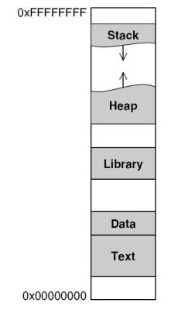
Memory Segments

Slide 48
Process Execution
During Program Execution
CPU fetches instructions from memory one at at time
The instruction pointer register (in CPU) dictates the next instruction to grab
Designates a memory address
Once it executes this instruction, the pointer is incremented and the next instruction is fetched
This linear progression occurs until a branch is reached
At a branch, the pointer's location is altered to become a new point in memory
Branches are caused by: conditionals, loops, subroutines, goto statements, etc.
The goal of the attacker is to redirect this flow of execution

Slide 49
The Stack
The stack stores information for each process running on a computer
Kind of like a scratch pad for a computer system
As a program runs, it stores important information on the stack
Similar to the stack from programming class (LIFO)
When data is retrieved from the stack, the system removes the last element placed on the stack

Slide 50
The Stack
The stack contains several different types of information
Return Address
The address to which control should return when the subroutine exits
Arguments
The values of the arguments passed to the subroutine
Local variables
Local variables created during the execution of the subroutine
Frame Pointer
Helps the system refer to various elements on the stack

Slide 51
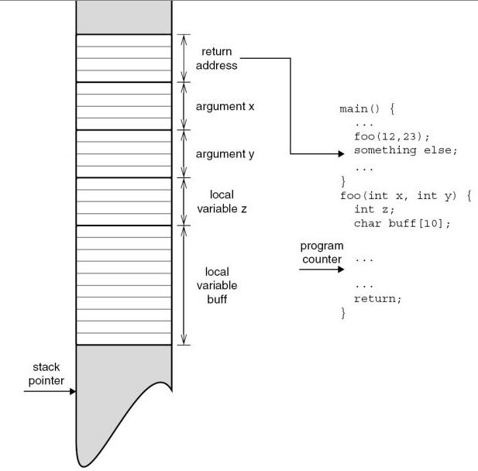
The Stack

Slide 52
Stack Smashing
The “classic” buffer overflow results in code injection directly into the stack
This is done by
Overflowing a buffer
Inserting machine code into the stack (overflowed buffer)
Overwriting the return pointer to point to the begining of the new code
Problem
The stack is dynamic
Memmory addresses change depending on which functions were called previously

Slide 53
How They Occur
Two buffer overflow flaws: gets and strcpy
Attacker can rewrite the return address and execute the code written on the stack

Slide 54
Buffer Overflow Anatomy
Most stack overflow attacks have 3 parts
Return Addresses
The attacker inserts a series of repeating return addresses that will override the default return address
Payload
This is the actual “shellcode” that will be executed on the misdirected “return”
Written in machine language
NOP sled
NOP is an assembly instruction for “No Operation”
This “sled” buffers the code and provides a “funnel” to the shellcode
This compensates for any misestimation in the location of the shellcode start address

Slide 55
Buffer Overflow Anatomy
Once the buffer has overflowed
Program execution continues until it reaches the series of return addresses
This assumes that the attacker did not overwrite any critical or protected memory space
At this point, the instruction pointer is redirected to point at the attacker's memory address space
If the memory adress is really off, the program will return to an invalid address or one with no execution code
If this happens, the process will crash – “segmentation fault”
If the attacker predicted reasonably, the pointer will land on the NOP sled, and “slide” to the machine code
Once it reaches the machine code, it will be executed

Slide 56
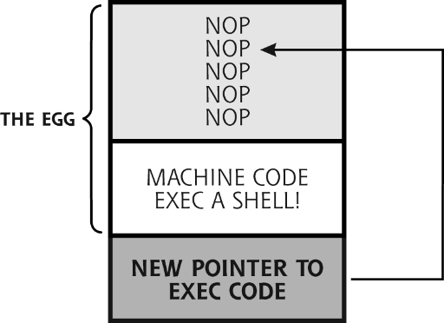
Buffer Overflow Anatomy

Slide 57
Other Types of Overflows
Heap Smashing
Attacker overflow heap buffers instead of stack buffers
Results are similar
Because of the subtle variations in the heap and its dynamic nature, heap smashing is more difficult than stack smashing
Return-to-libc
A simple variation on stack and heap smashing
Instead of returning to custom machine code, attacker puts in return address the address of a standard library function
Attacker makes sure his/her arguments are on stack in proper place when this function is called (e.g. system())

Slide 58
Other Types of Overflows
Overwriting Variables
Rather than inserting code, an attacker may aim to overwrite critical information
e.g., on early unix systems, the password authenication mechanism could be overflowed
Allowes the insertion of arbitray password as valid.
You could log-in without even breaking the password!

Slide 59
Buffer Overflows – Network Security?
Why should we be concerned about buffer overflows?
There are many applications which get their input from the network
Even the network stack is just a process running on a machine!
Properly crafted input to a vulnurable program can lead to
Loss of service (due to system / process crashes)
Corrupted information
System compromise
Execution of arbitrary code within “trusted” perimeter

Slide 60
Preventing Buffer Overflows
Nonexecuable Stacks
OS does not allow code execution from the stack
Not as trivial as it sounds
Canaries
Add known values to stack (next to return pointer)
The value is a rehash of the return pointer with system’s special secret
Before returning / executing, check values
Address Randomizaiton
Stack address space is randomized at begining of process
Vista uses stack address randomization
Careful coding & code analyzers
Fuzzing: varying user input to try to make a target system behave in a strange fashion

Slide 61
Remember ARP?

Slide 62
ARP Poisoning / Spoofing
Often used by attackers to redirect LAN traffic
Want to sniff traffic on switched ethernet
Want to spoof traffic and need to see responses
Often used as part of session hijacking
May just want to cause DoS of network traffic
Or a particular host
Possible because ARP has no authentication
Worse with hosts that accept gratuitous ARP packets
Gratuitous ARP request – ARP request with the same source and destination IP and the broadcast address as destination MAC (ff:ff:ff:ff:ff:ff). No reply paket will occer
Gratuitous ARP reply – a reply to which no request has been made

Slide 63
ARP Poisoning / Spoofing
Can be done in one of two ways
Flood the network with spoofed ARP packets
Some machines will add these to cache immediately
Others will pick them up after issuing an ARP requst
Can be used to disrupt normal traffic flow or to sniff traffic
Easy to detect
Use well-timed, directed packets to redirect traffic
Can redirect one host's traffic
Can redirect ALL traffic
Can configure IP forwarding to maintain normal network operation

Slide 64
ARP Poisoning / Spoofing
Sniffing on a switched LAN using IP forwarding

Slide 65
IP Address Spoofing
Referrs to the creation of IP packets with incorrect source IP addresses
Used for several different purposes
To gain access to a “trusting” system
Note: Authentication based on IP address is ALWAYS a bad idea
To preform “firewalking” or test firewall
Also applies to other network devices
To attempt to hide the address of the sender
IP spoofing is rather trivial to impliment and can be achieved in different ways depending on the goal

Slide 66
IP Address Spoofing
Address spoofing is possible because IP is not authenticated
Can be prevented by using another, security-enabled, protocol (IPsec, SSL, etc.)
Becoming harder today because of egress filtering by ISPs and backbone providers

Slide 67
DNS Spoofing
Another method to redirect traffic for
Sniffing
Pharming (redirect a website's traffic to another, bogus site)
etc.
Method
Attacker sniffs LAN and waits for DNS query to be issued
Issues a spoofed DNS response
Victim uses spoofed response and navigates to designated IP
User is never aware that he/she is not connected to legitimate host
Attacker may setup false site or act as man-in-the-middle
Often involves a method to redirect traffic

Slide 68
DNS Spoofing

Slide 69
Review – TCP Connections
TCP is a stateful protocol
Client wants to initiate connection to server
It sends a special TCP segment to the server with the SYN bit set to 1
Let the initial sequence number be client_isn
This is called a SYN segment
Server receives the SYN segment
It allocates buffers and variables to the connection and replies
Reply has SYN = 1, acknowledgment number = client_isn +1
Sequence number is server_isn
This is called a SYNACK segment
Client sends ACK segment
Connection is completed
This is called the “three way handshake”

Slide 70
TCP Session Hijacking
In TCP session hijacking, an attacker attempts to take control of a session that is already established
This may circumvent some authentication, username & password exchanges, token IDs, etc.
Many these things occur above the transport layer
The ultimate purpose is to gain access to a system or session by pretending to be a legimitate user

Slide 71
TCP Session Hijacking
May be:
Active
Attacker hijacks session and uses it to gain control over a target system
Passive
Attacker hijacks session and observes traffic passing between hosts
Active hijacking begins with passive hijacking
Hijacking is different from session replay (both are man-in-the-middle attacks)
Session Replay – capture packets and modify data before sending to target (not realtime)
Session Hijacking – Spoof the source, change your TCP seq. numbers to match the source, DoS attack the source, and spoof its existence

Slide 72
Hijacking vs. Replay
Session Replay:
Session Hijacking:

Slide 73
TCP Session Hijacking
May also be
Non-Blind
In a non-blind attack, an attacker can view all traffic between the two hosts
Easier to impliment (no guessing)
This may be achieved using ARP spoofing, MAC flooding, IP routing modifications, etc.
Blind
Attacker cannot see traffic between the two hosts
Must successfully guess the sequence numbers between the two hosts
This is increasingly more difficult (improved sequence generators)
Session hijacking only works againt connection oriented protocols (in general)

Slide 74
TCP Session Hijacking
One Scenario:
Alice initiates a legimitate telnet connection with Bob
Oscar sits in the middle between Alice and Bob and observes all of their traffic
At some point, Oscar prevents Alice from sending traffic to Bob
At the same time, he begins sending spoofed traffic to Bob, posing as Alice
Bob listens to Oscar as if he were Alice

Slide 75
TCP Session Hijacking
Hijacking a TCP session relies on being able to
Spoof traffic as if it is coming from somewhere else
Observe the traffic coming from Bob OR be able to guess the TCP sequence numbers
In the previous scenario
Oscar was able to sniff all of the traffic between Alice and Bob
This may not be the case

Slide 76
Review – TCP Connections
TCP is a stateful protocol
Client wants to initiate connection to server
It sends a special TCP segment to the server with the SYN bit set to 1
Let the initial sequence number be client_isn
This is called a SYN segment
Server receives the SYN segment
It allocates buffers and variables to the connection and replies
Reply has SYN = 1, acknowledgment number = client_isn +1
Sequence number is server_isn
This is called a SYNACK segment
Client sends ACK segment
Connection is completed
This is called the “three way handshake”

Slide 77
Guessing Sequence Numbers
Many times, and attacker may not be able to sniff traffic
He/She must be able to guess sequence numbers
Many TCP implementations use predictable ways of generating sequence numbers
Old versions of Berkeley implementation used to increment the sequence number 128 times a second
The recommendation in the TCP specification is to increment it 250000 times a second
The idea is that the round trip time measured or predicted by Oscar will be random enough to prevent him from guessing the sequence number
Oscar can still guess a range of sequence numbers and send several packets back to the server - at least one will be correct

Slide 78
Guessing Sequence Numbers
The random number generator can be reverse engineered under certain circumstances
Collect previous sequence numbers
Subject them to analysis
Many types of analyses exist
Phase-space analyses
In some cases, with knowledge of three prior sequence numbers, Oscar can guess the next one with 100% probability
Attack Feasibility of
Different OSs
Preliminary results
OS
Feasibility
Win2k/XP
12%
Solaris
0.02%
Mac OS X
0%
Cisco IOS
0%

Slide 79
Mitnick's Attack
This attack used SYN floods and session hijacking together
Idea:
Allow a legitimate connection to be set up between a client and a server
Flood one of the parties with SYN packets thereby making them unavailable for response
Masquerade as the party that has been silenced by the SYN flood
Mitnick first probed the target to determine who is logged on
Used finger, showmount and rpcinfo
Most sites block finger and rpcinfo from outside hosts
Mitnick used these to determine the way TCP sequence numbers were created by the target

Slide 80
Mitnick's Attack
Step 1. - Use finger, showmount, and rpcinfo against target server
Step 2. - Launch SYN Flood against target server
Step 3. - Determine the initial sequence number (ISN)
Step 4. - Launch an xterm rshell daemon to diskless workstation
Step 5. - Spoof the reply from server to workstation
Step 6. - Extend access by modifying the .rhosts file
He gives no-password access to everyone
Step 7. - Send FIN message to clear connection from workstation
Step 8. - Send RST to server to clear target queue
Step 9. - Compile and install tap-2.01 kernel module
Step 10. - Hijack session from workstation to target
The actual session hijacking
It all took ~ 42 minutes

Slide 81
Unintended (?) Consequences
One side effect of a session hijack can be an “ACK storm”
This can inadvertantly launch a DoS against the networks between Alice and Bob

Slide 82
DoS Attacks
DoS attacks can be devestating for a network. They result in
Down time
Loss of Revenue
Hardware & software damage
They are also very hard to prevent, as they exploit normal network traffic
A brute force DoS is always possible
Accidental DoS can be caused by unusual (legitimate) interest in an unprepared organization
DoS attacks are among the most common today

Slide 83
TCP SYN Flood
Recall (once again) that TCP is stateful
When a connection is initiated
Alice sends Bob a SYN packet
Bob allocates resources for the TCP connection
Bob sends back a SYN ACK
Alice responds with an ACK and the connection is complete
But what if Alice never responds?
Bob should wait a time-out period before releasing the resources he allocated

Slide 84
TCP SYN Flood
Now, what if
Alice continually initiates connections with Bob
She never completes any of them
What happens to Bob's resources?
Eventually they run out
Bob will stop accepting connections
Bob is essentially shut down (unavailable)
Can be achieved with less traffic than brute force DoS

Slide 85
Smurf and Fraggle Attacks
Smurf Attack
Takes advantage of IP broadcast address
Concept:
Send a spoofed ping (with target’s address) to a network's broadcast address (the bigger the network, the better)
Each host that receives the ping on the target network will respond, almost simultaneously
Result – instant DDoS
Fraggle Attack
The concept is the same
Uses CHARGEN and ECHO UDP services instead of ICMP
UDP ports 19 and 7, respectively

Slide 86
LAND Attack
In a land attack:
A single packet is sent to target
Packet has the same source and destination address and port number
When host recieves this packet, it usually slows down or comes to a halt
Host tries to initiate a connection with itself in an infinite loop
This is essentially a failure in the network stack implimentation

Slide 87
Teardrop Attack
Also takes advantage of stack implimentation failure
Attacker sends a fragmented packet to the target
This packet has overlapping fragments
Fragment offset fields are set incorrectly so that the fragments do not align when reassembled
Some implimentations of the TCP/IP stack cause a system crash when they attempt to reassemble the packet

Slide 88
Ping of Death
Again, stack implimentation failure
Attacker sends a ping packet to the target
This ping packet has a size larger than the maximum allowed size (65,535 bytes)
Vulnurable systems will crash due to the inability to reassemble the oversized ICMP packet
Maximum offset is 65,528

Slide 89
Winnuke
As the name implies, only windows systems are vulnurable (older ones)
Concept:
Packets with “out of band” data are sent to port 139 (SMB) on a windows box
“out of band” data = TCP urgent data flag was set
When the packet arrives, the operating system does not handle the data properly
The result is a system crash (via the “Blue Screen of Death”)

Slide 90
Tools
There are many tools for testing and executing the attacks mentioned (as well as a slew of other attacks)
Some attacks (particularly the newer ones) require that the attacker impliment his or her own software
Sometimes they are helped with pre-written libraries
Tools references:
http://sectools.org/
http://www.foundstone.com/us/index.asp
http://www.metasploit.com/
http://www.nessus.org/nessus/
http://www.remote-exploit.org/
Cisco Penetration Testing & Network Defense
and a LOT more

Slide 91
Announcements
Lab 1
Friday 9am-12pm
Due Feb. 5
Grades have been posted for Quiz 1
Another quiz next session (Jan. 31)

